Slide 1

236781
Lecture 6
Deep learning
Self-supervised learning
Dr. Chaim Baskin

Slide 2
Motivation
Recall the idea of transfer learning: start with general-purpose feature representation pre-trained on a large, diverse dataset and adapt it to specialized tasks
Challenge: overcoming reliance on supervised pre-training
Pretext task
Figure source

Slide 3
Unsupervised vs. self-supervised learning
Unsupervised learning: any kind of learning without labels
Clustering and quantization
Dimensionality reduction, manifold learning
Density estimation
Learning to sample
Self-supervised learning: a type of unsupervised learning in which the learner “makes up” labels from the data and then solves a supervised task

Slide 4
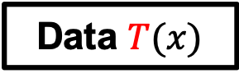
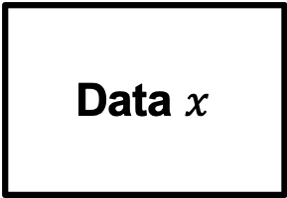
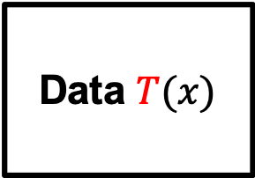
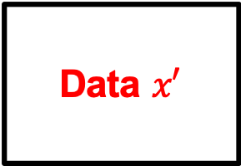
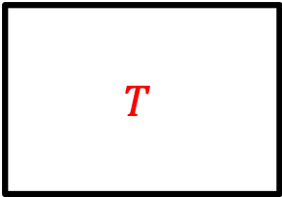
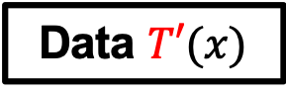
Self-supervised learning: Outline
Data $x$
Network
Data $x′$
Data prediction
Transformation prediction
Data $T(x)$
Network
$$T$$
“Siamese” methods
Data $T(x)$
Network
Similarity score
Data $T′(x)$
Network
Source: A. Efros

Slide 5
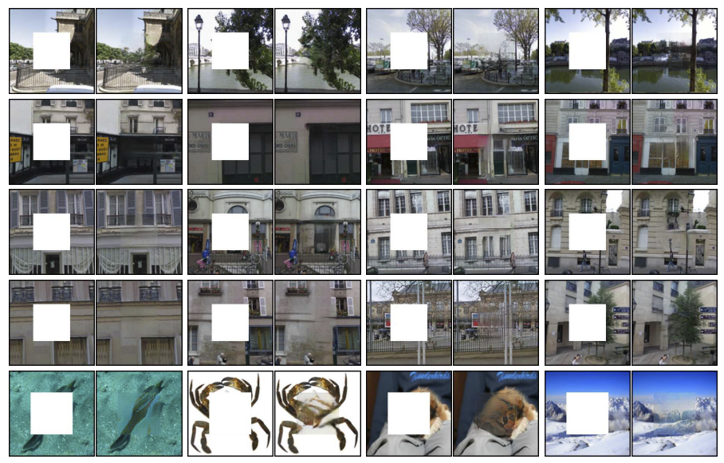
Data prediction: Inpainting
D. Pathak, P. Krahenbuhl, J. Donahue, T. Darrell, A. Efros. Context Encoders: Feature Learning by Inpainting. CVPR 2016

Slide 6
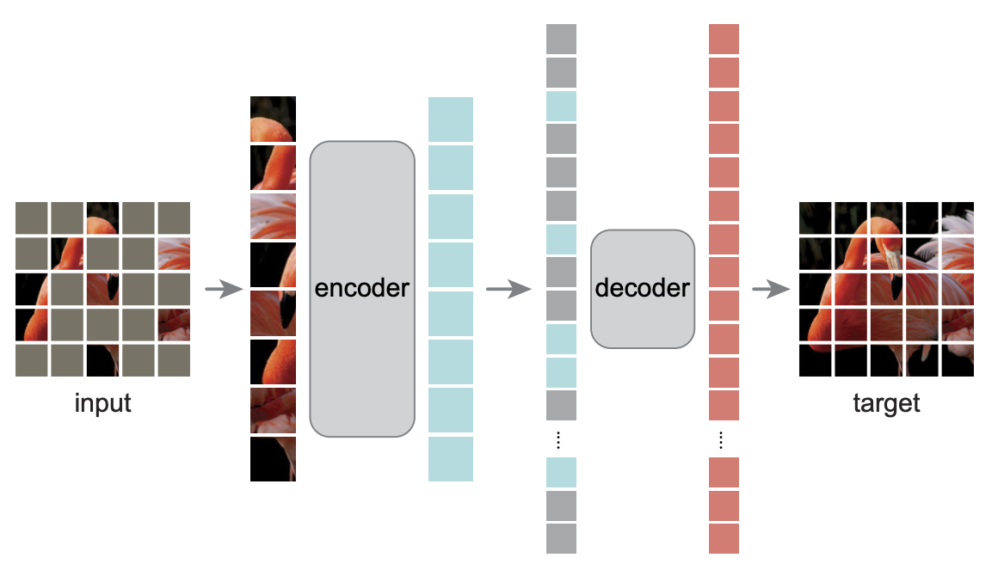
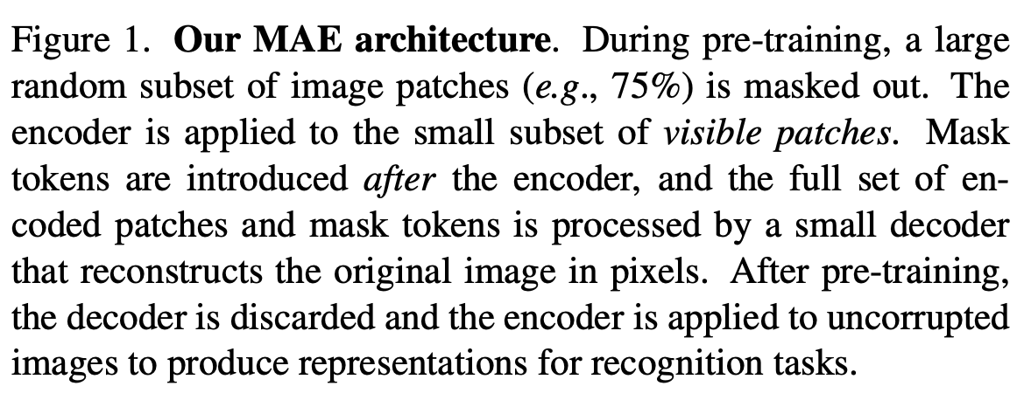
Preview: Masked autoencoders
K. He et al. Masked autoencoders are scalable vision learners. CVPR 2022

Slide 7
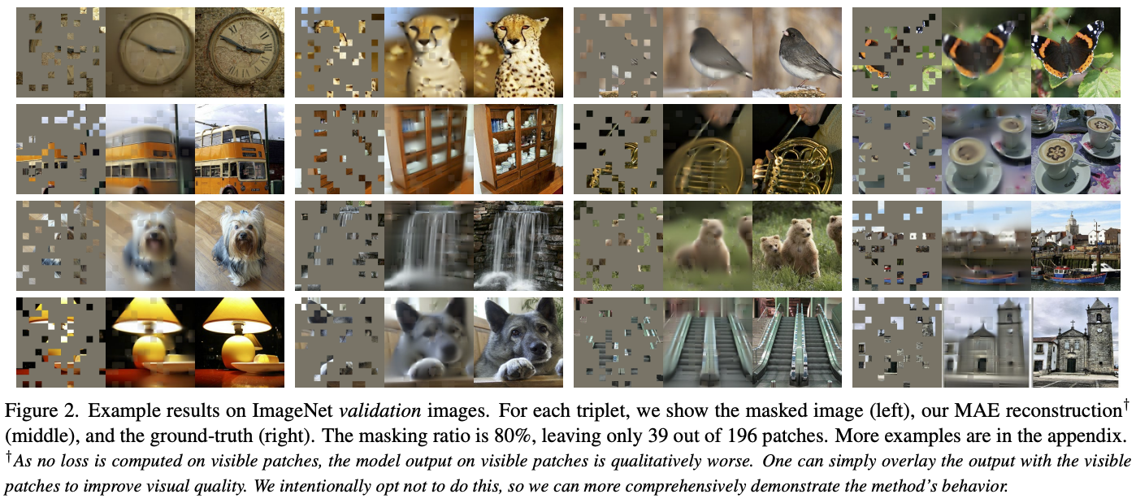
Preview: Masked autoencoders
K. He et al. Masked autoencoders are scalable vision learners. CVPR 2022

Slide 8
Colorization
R. Zhang, P. Isola, and A. Efros, Colorful Image Colorization, ECCV 2016
Notes:
At each spatial location, predict probability distribution over 313 quantized (a,b) values

Slide 9
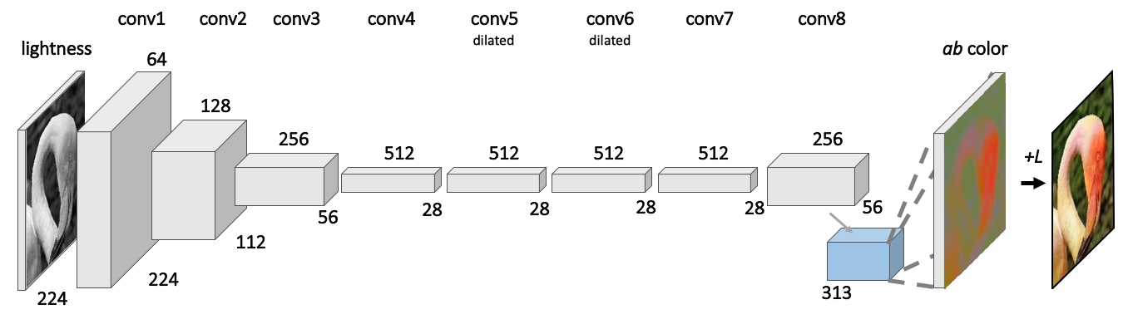
Colorization: Architecture
R. Zhang, P. Isola, and A. Efros, Colorful Image Colorization, ECCV 2016
Notes:
At each spatial location, predict probability distribution over 313 quantized (a,b) values

Slide 10
Dilated convolutions
Idea: instead of reducing spatial resolution of feature maps, use a large sparse filter
Also known as à trous convolution
Dilation factor 1
Dilation factor 2
Dilation factor 3
Image source

Slide 11

Dilated convolutions
Idea: instead of reducing spatial resolution of feature maps, use a large sparse filter
output
Like 2x downsampling followed by 3x3 convolution followed by 2x upsampling
input
V. Dumoulin and F. Visin, A guide to convolution arithmetic for deep learning, arXiv 2018

Slide 12
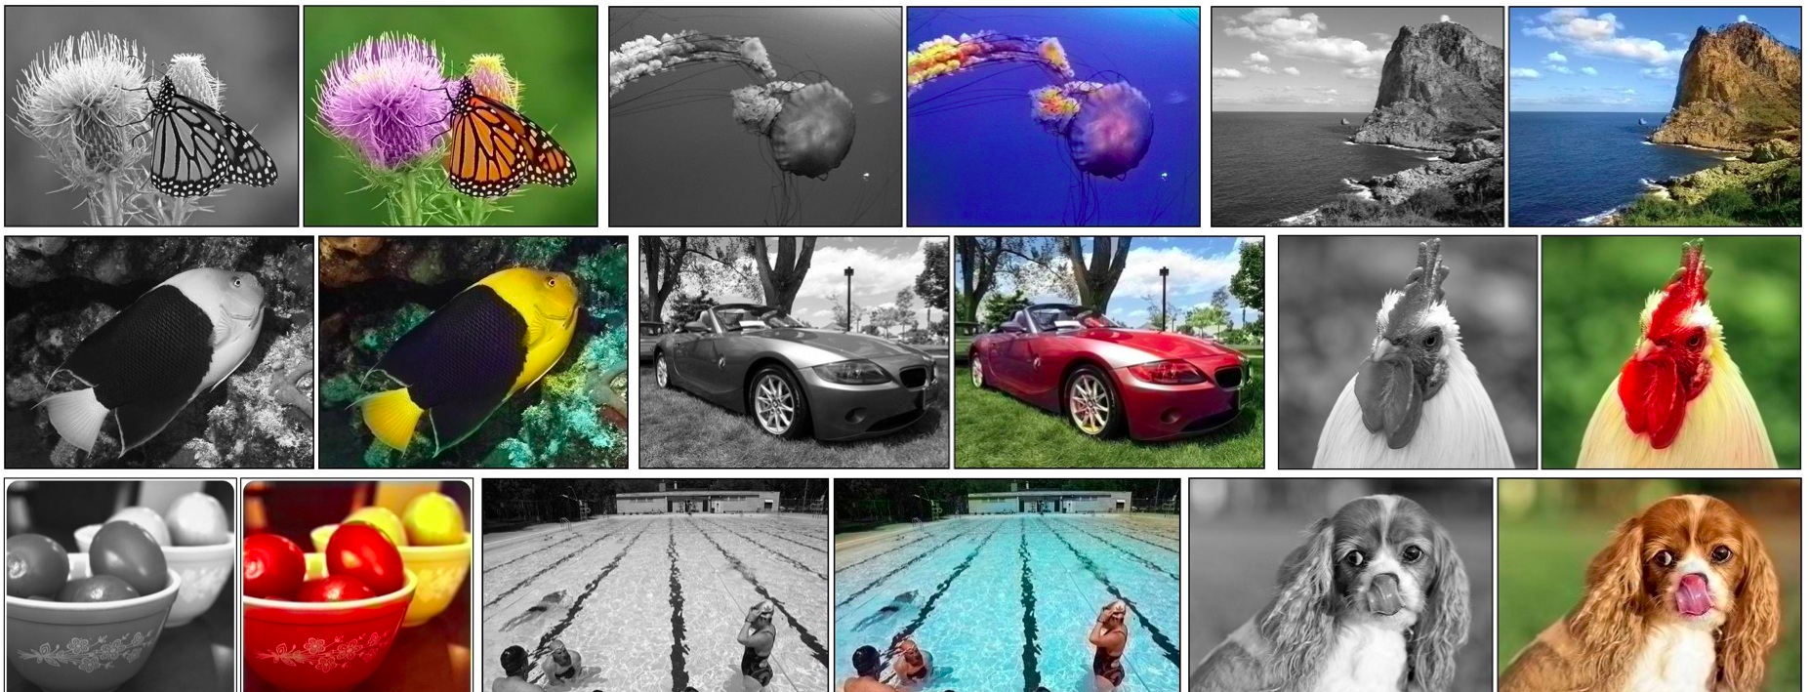
Colorization: Results
R. Zhang, P. Isola, and A. Efros, Colorful Image Colorization, ECCV 2016
Notes:
At each spatial location, predict probability distribution over 313 quantized (a,b) values

Slide 13
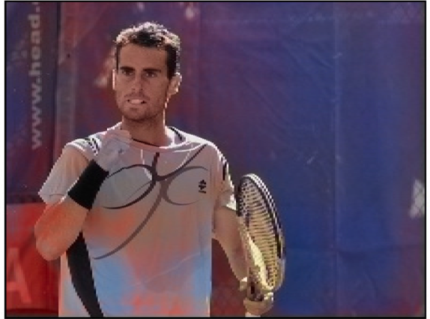
Failure Cases
Source: A. Efros, R. Zhang
Notes:
The system does have some interesting failure cases. We find that many man-made objects can be multiple colors. The system sometimes has a difficult time deciding which one to go with, leading to this type of tie-dye effect.

Slide 14
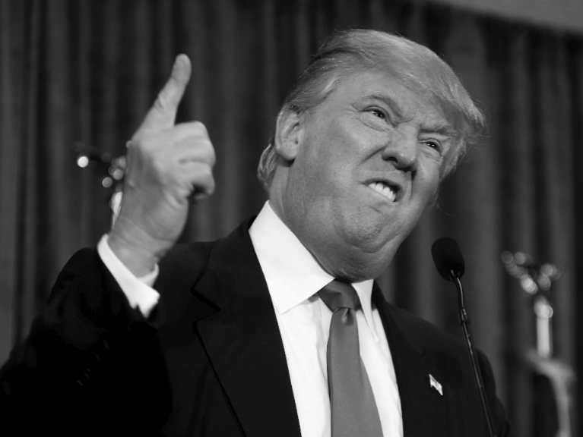
Inherent Ambiguity
Grayscale
Source: A. Efros, R. Zhang
Notes:
For example, consider this grayscale image.

Slide 15
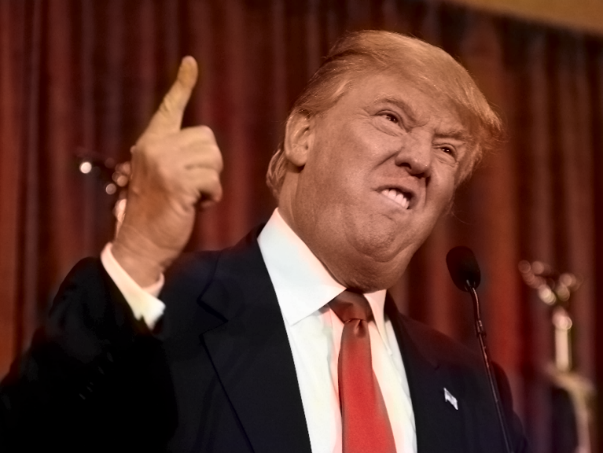
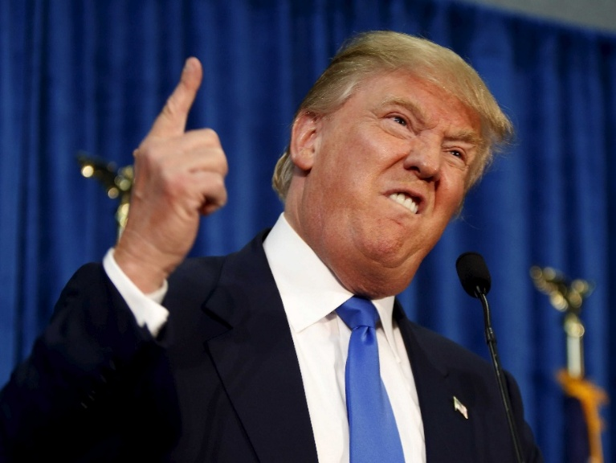
Inherent Ambiguity
Prediction
Ground Truth
Source: A. Efros, R. Zhang
Notes:
This is the output after passing it through our system. Now, it seems to look plausible. Now here is the ground truth. So notice that these two look very different. But even though red and blue are far apart in ab space, we are just as happy with the red colorization as we are with the blue, and perhaps the red is even better...

Slide 16
Biases
Source: A. Efros, R. Zhang
Notes:
Also, we find other curious behaviors and biases. For example, when the system sees a dog, it sometimes expects a tongue underneath. Even when there is none, it will just go ahead and hallucinate one for us anyways.

Slide 17
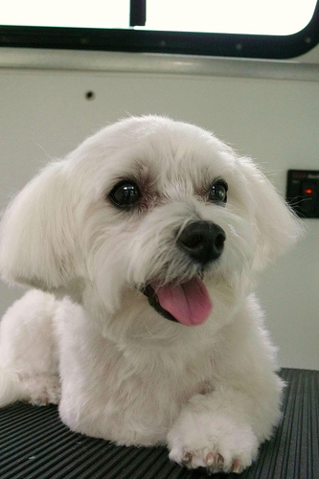
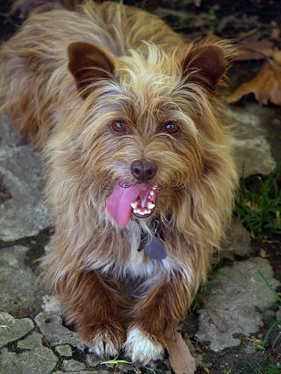
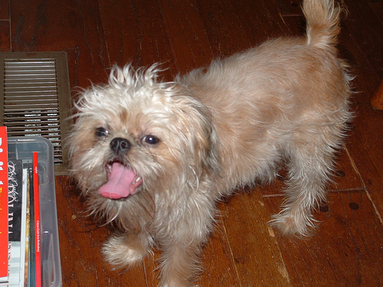
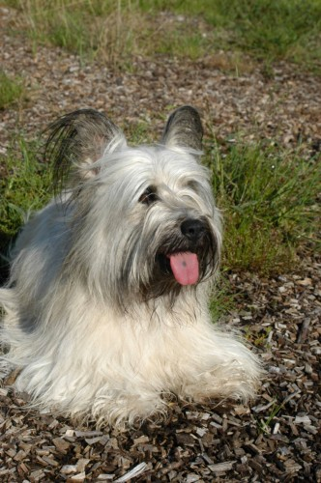
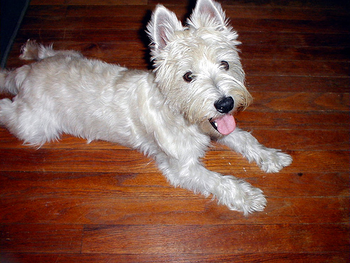
Biases
Source: A. Efros, R. Zhang
Notes:
Also, we find other curious behaviors and biases. For example, when the system sees a dog, it sometimes expects a tongue underneath. Even when there is none, it will just go ahead and hallucinate one for us anyways.

Slide 18
Self-supervised learning: Outline
Data $x$
Network
Data $x′$
Data prediction
Transformation prediction
Data $T(x)$
Network
$$T$$

Slide 19
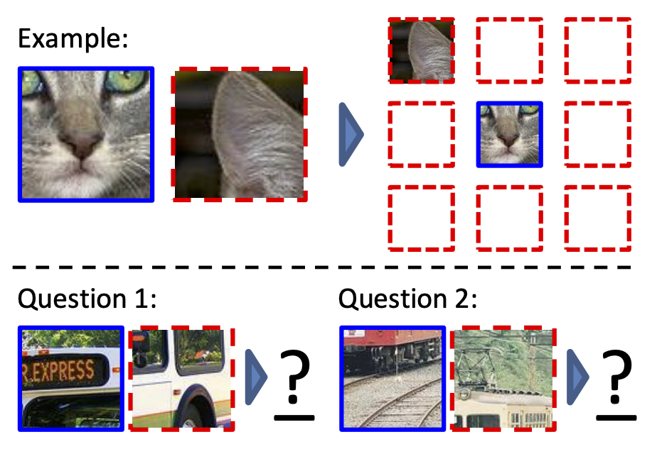
Context prediction
Pretext task: randomly sample a patch and one of 8 neighbors
Guess the spatial relationship between the patches
A: Bottom right
A: Top center
C. Doersch, A. Gupta, A. Efros. Unsupervised Visual Representation Learning by Context Prediction. ICCV 2015

Slide 20
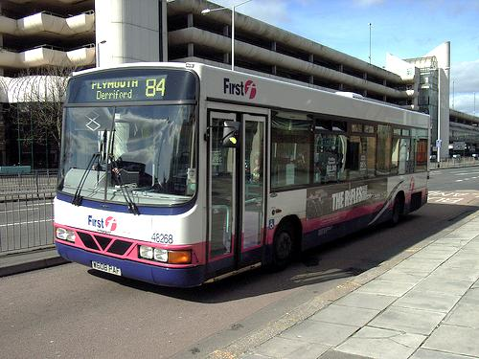
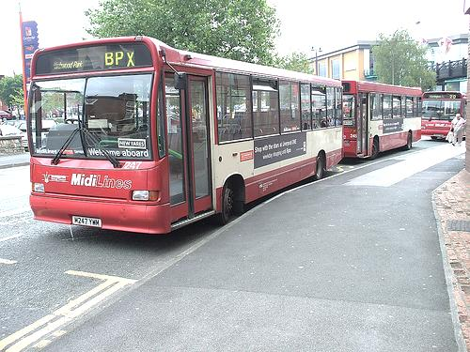
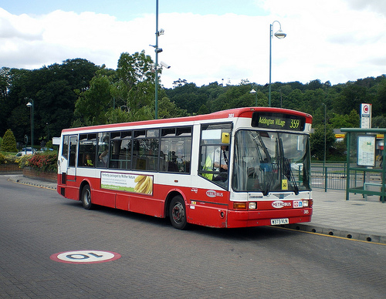
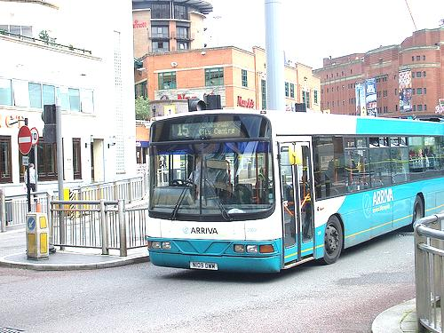
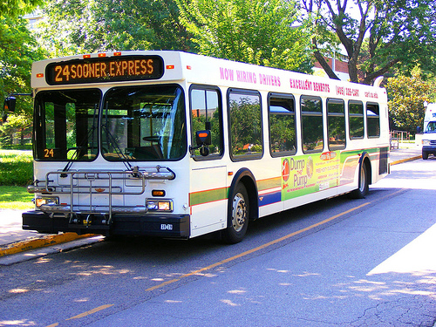
Context prediction: Semantics from a non-semantic task
Source: A. Efros
Notes:
- This is hard if you don’t know what a bus is, but easy if you do.
- We hope that if we give this task to a machine learner, it will also solve it by recognizing semantics.

Slide 21
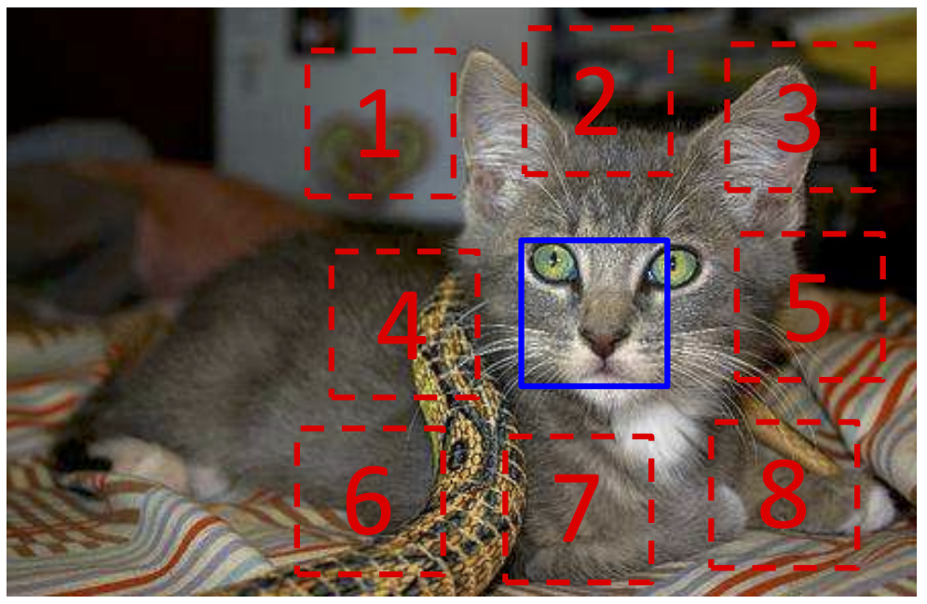
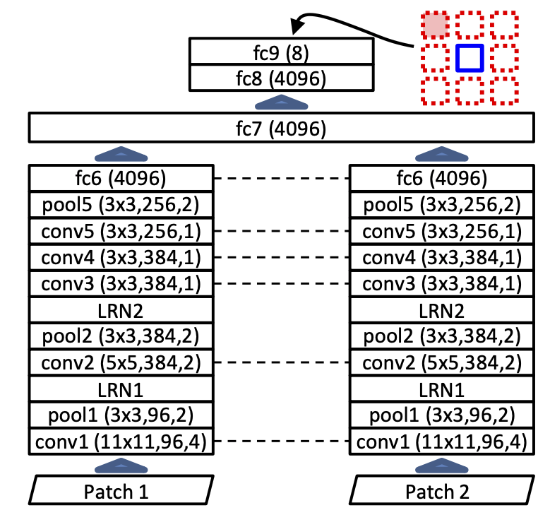
Context prediction: Details
AlexNet-like architecture
softmax
Prevent “cheating”: sample patches with gaps, pre-process to overcome chromatic aberration
shared weights
C. Doersch, A. Gupta, A. Efros. Unsupervised Visual Representation Learning by Context Prediction. ICCV 2015

Slide 22
Context prediction: Results
Combine learned feature extractor with R-CNN to perform detection on PASCAL VOC 2007
Unsupervised pre-training is 5% mAP better than training from scratch, but still 8% below pre-training with ImageNet label supervision
C. Doersch, A. Gupta, A. Efros. Unsupervised Visual Representation Learning by Context Prediction. ICCV 2015

Slide 23
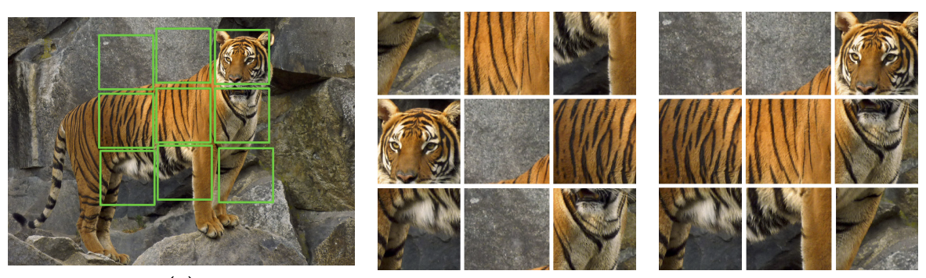
Jigsaw puzzle solving
Crop out tiles
Shuffle
Pretext task: reassemble
Claim: jigsaw solving is easier than context prediction, trains faster, transfers better
M. Noroozi and P. Favaro. Unsupervised Learning of Visual Representations by Solving Jigsaw Puzzles. ECCV 2016
Notes:
From the paper: “The association of each separate puzzle tile to a precise object part might be ambiguous. However, when all the tiles are observed, the ambiguities might be eliminated more easily because the tile placement is mutually exclusive.”

Slide 24
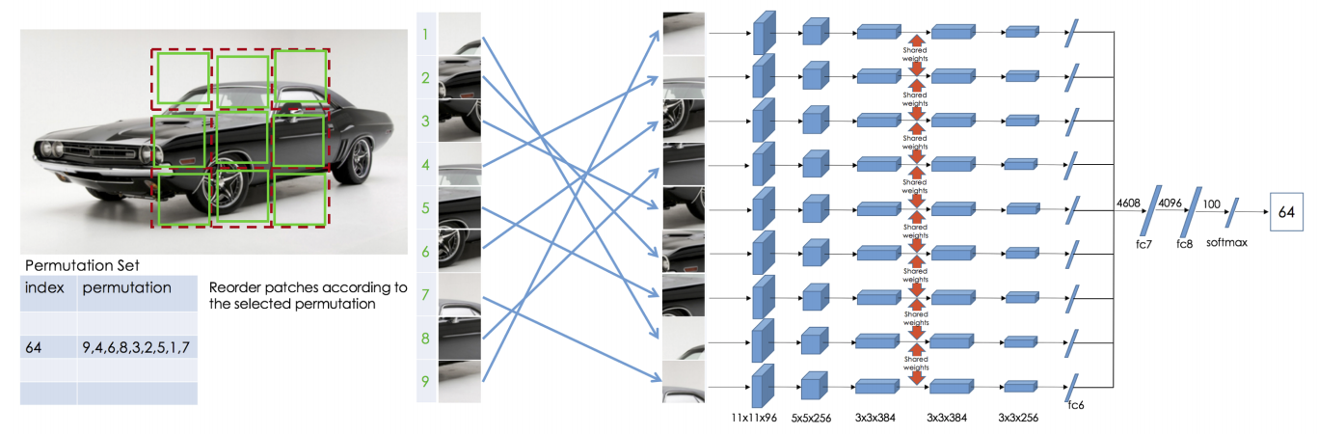
Jigsaw puzzle solving: Details
Context free network (CFN)
Predetermined set of 1000 permutations
(out of 362,880 possible)
M. Noroozi and P. Favaro. Unsupervised Learning of Visual Representations by Solving Jigsaw Puzzles. ECCV 2016
Notes:
“We call this architecture the context-free network (CFN) because the data flow of each patch is explicitly separated until the fully connected layer and context is handled only in the last fully connected layers.”

Slide 25
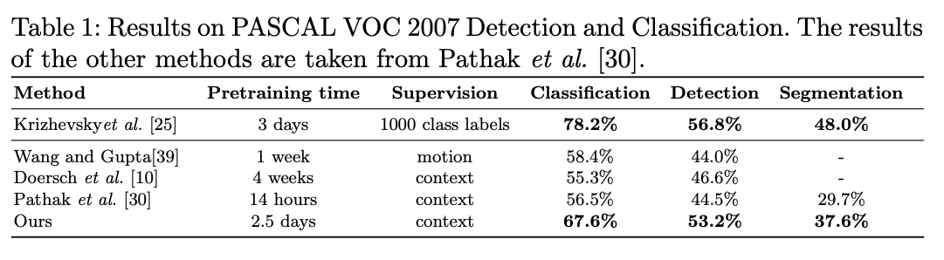
Jigsaw puzzle solving: Transfer results
M. Noroozi and P. Favaro. Unsupervised Learning of Visual Representations by Solving Jigsaw Puzzles. ECCV 2016

Slide 26
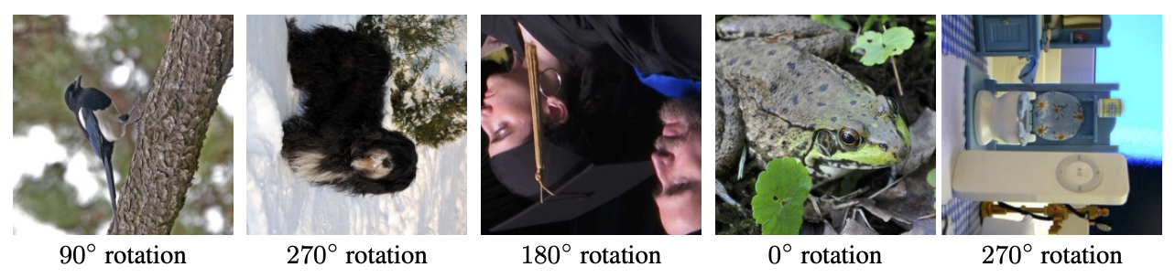
Rotation prediction
Pretext task: recognize image rotation (0, 90, 180, 270 degrees)
S. Gidaris, P. Singh, and N. Komodakis. Unsupervised representation learning by predicting image rotations. ICLR 2018

Slide 27
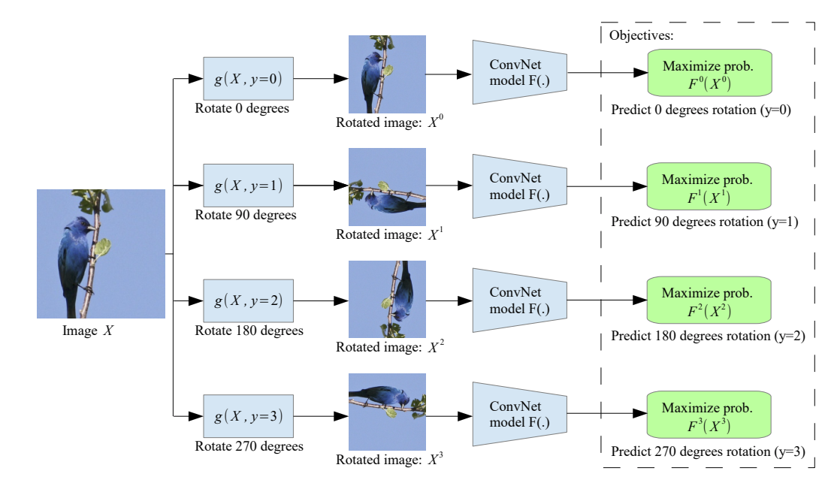
Rotation prediction
During training, feed in all four rotated versions of an image in the same mini-batch
S. Gidaris, P. Singh, and N. Komodakis. Unsupervised representation learning by predicting image rotations. ICLR 2018

Slide 28
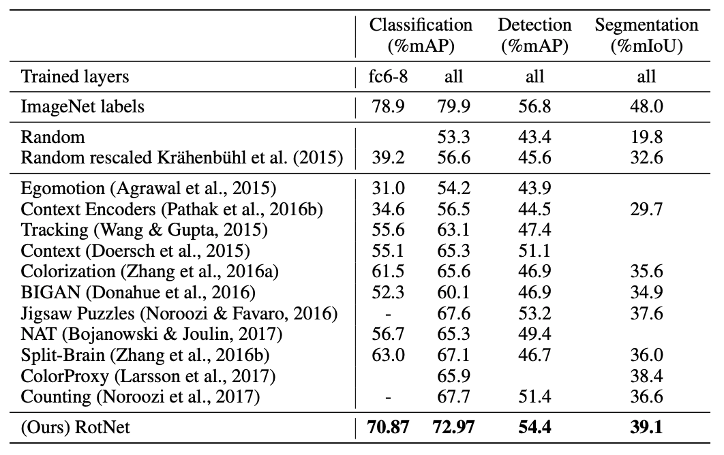
Rotation prediction: Transfer results
S. Gidaris, P. Singh, and N. Komodakis. Unsupervised representation learning by predicting image rotations. ICLR 2018

Slide 29
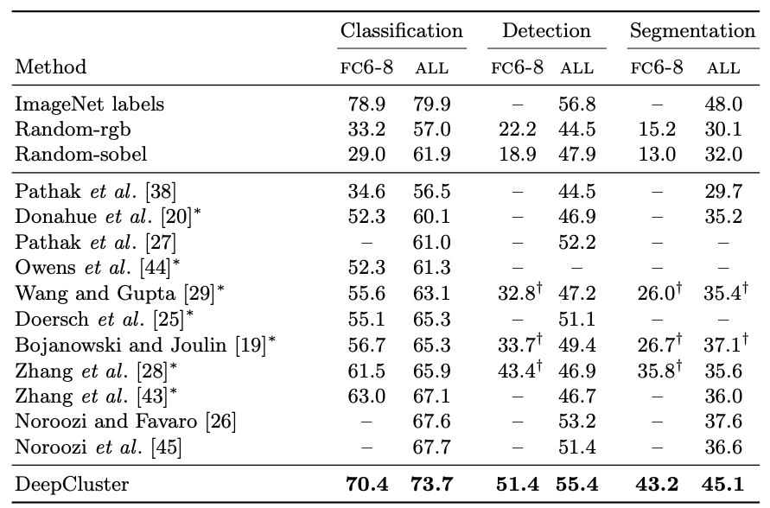
Rotation prediction: PASCAL VOC Transfer results
Method | Classification | Detection (mAP) | Segmentation (mIoU)
Supervised (ImageNet) | 79.9 | 56.8 | 48.0
Colorization | 65.6 | 46.9 | 35.6
Context | 65.3 | 51.1
Jigsaw | 67.6 | 53.2 | 37.6
Rotation | 73.0 | 54.4 | 39.1

Slide 30
Last time: Self-supervised learning
Data $x$
Network
Data $x′$
Data prediction
Transformation prediction
Data $T(x)$
Network
$$T$$
“Siamese” methods
Data $T(x)$
Network
Similarity score
Data $T′(x)$
Network
Source: A. Efros

Slide 31

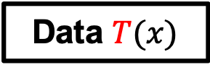
“Siamese” methods
Extract representations from two transformed versions of a data point, encourage these representations to be similar
Contrastive methods: train using both positive (similar) and negative (dissimilar) pairs
Non-contrastive methods: train with only positive examples
Data $T(x)$
Network
Similarity score
Data $T′(x)$
Network
Source: A. Efros

Slide 32
Contrastive methods
Encourage representations of transformed versions of the same image to be the same and different images to be different
Figure source

Slide 33
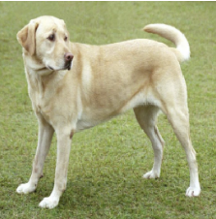
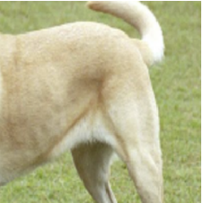
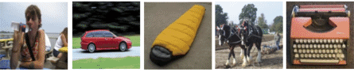
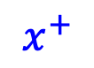
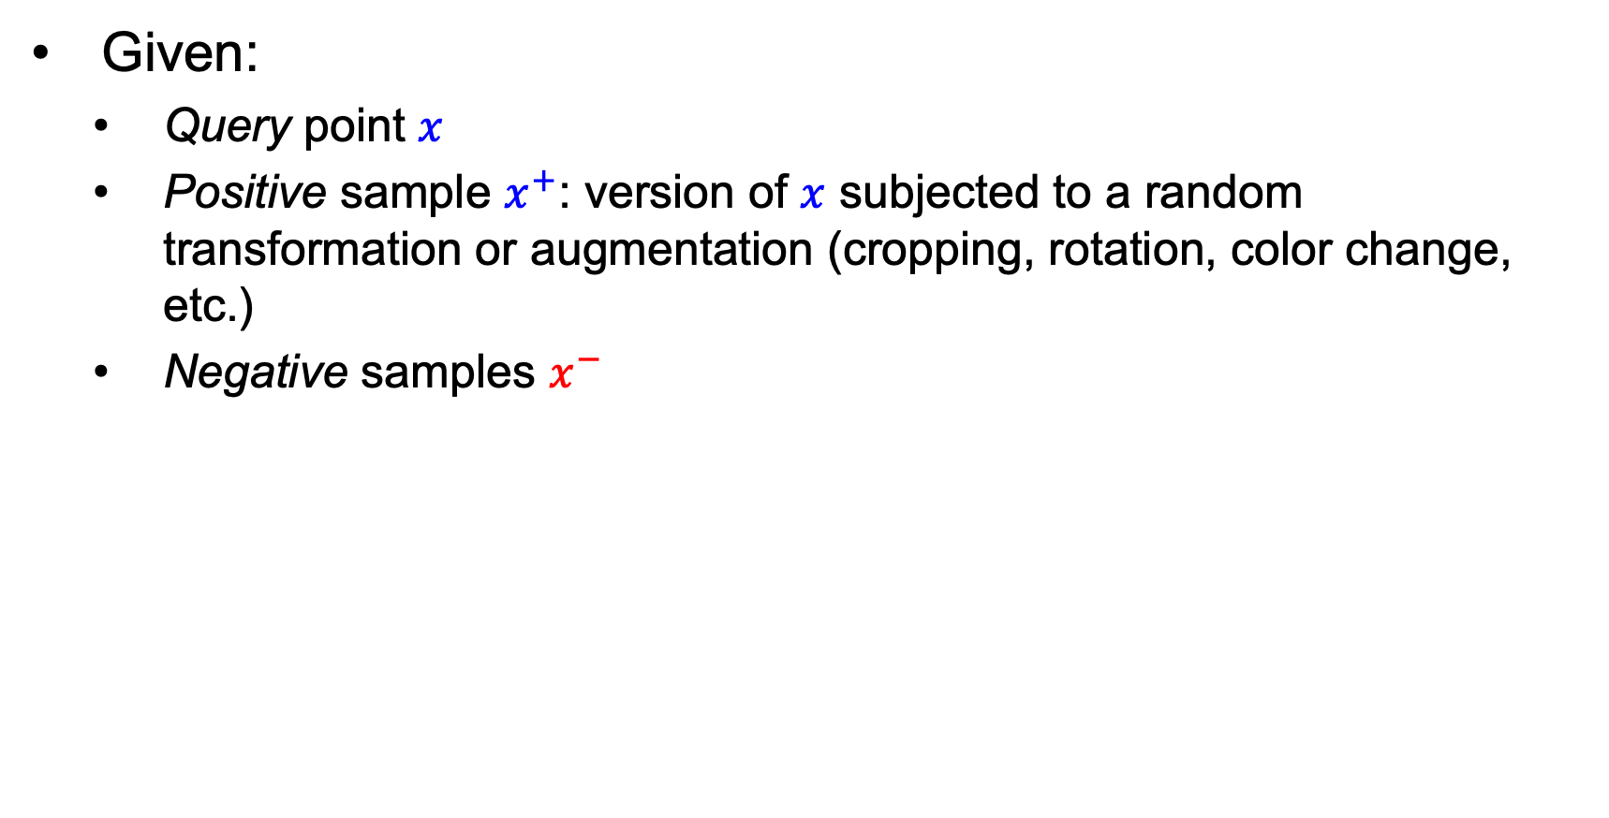
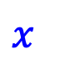
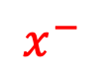
Contrastive loss formulation
Given:
Query point $x$
Positive sample $x^{+}$: version of $x$ subjected to a random transformation or augmentation (cropping, rotation, color change, etc.)
Negative samples $x^{−}$
$x$
$$x^{+}$$
$$x^{−}$$
Notes:
Intuitively, the loss is that of a softmax classifier that tries to classify x as x+

Slide 34
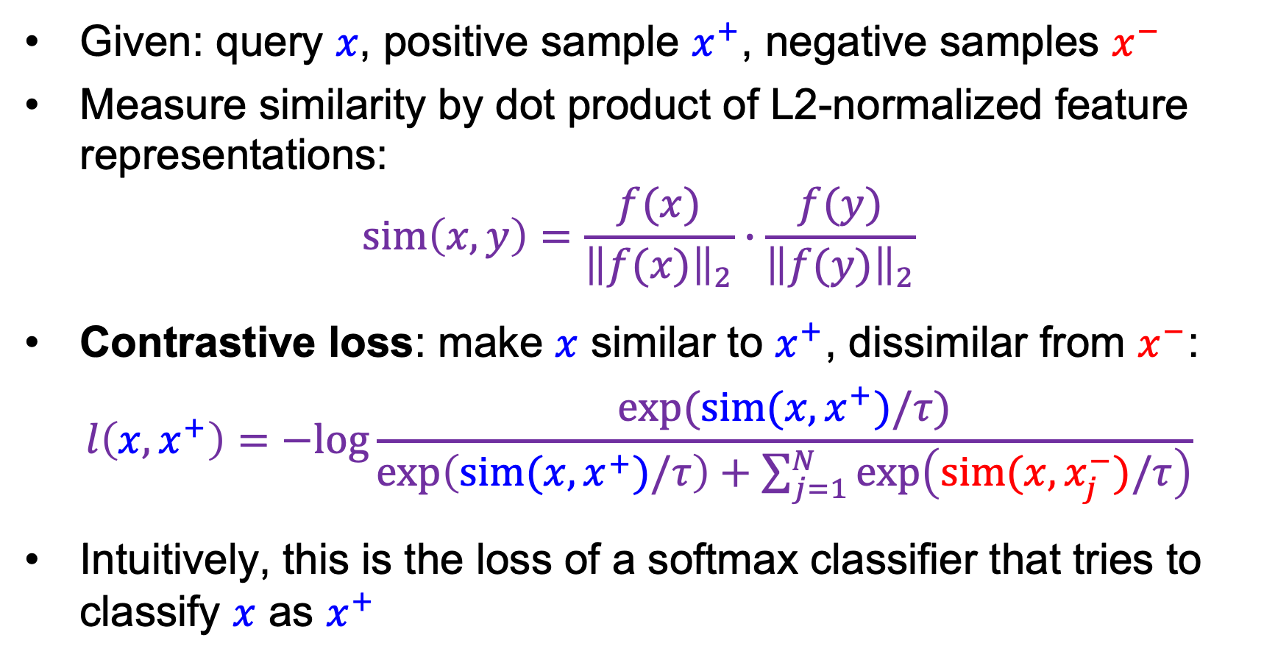
Contrastive loss formulation
Given: query $x$, positive sample $x^{+}$, negative samples $x^{−}$
Measure similarity by dot product of L2-normalized feature representations:
$$sim\left(x,y\right)=\frac{f(x)}{{\left\|f(x)\right\|}_{2}}∙\frac{f(y)}{{\left\|f(y)\right\|}_{2}}$$
Contrastive loss: make $x$ similar to $x^{+}$, dissimilar from $x^{−}$:
$$l\left(x,x^{+}\right)=−log\frac{exp⁡(sim(x,x^{+})/τ)}{\exp\left(sim(x,x^{+})/τ\right)+\sum_{j=1}^{N}{\exp\left(sim(x,x_{j}^{−})/τ\right)}}$$
Intuitively, this is the loss of a softmax classifier that tries to classify $x$ as $x^{+}$
Notes:
Intuitively, the loss is that of a softmax classifier that tries to classify x as x+

Slide 35
Recall: Softmax with temperature
Low temperature:
More concentrated distribution
Higher temperature:
More uniform distribution
Figure source

Slide 36
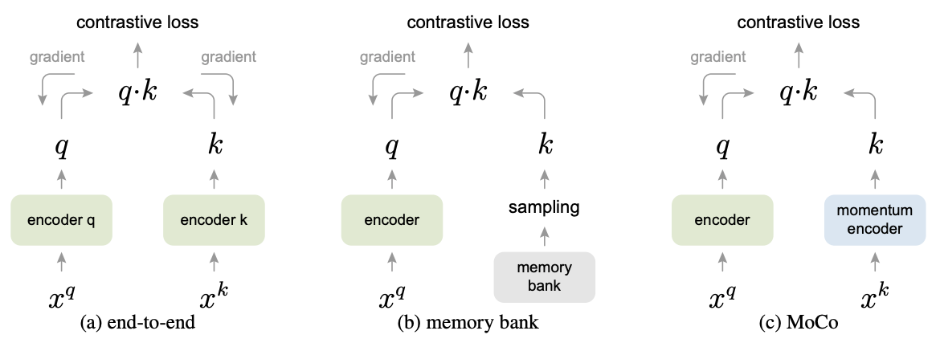
Mechanisms for obtaining negative samples
End-to-end: dictionary of negative examples is the current minibatch
Pro: dictionary is encoded using latest encoder parameters
Con: needs large minibatches to work well, but back-propagating through negative samples is compute- and memory-intensive
query
(pos. data point)
key from dictionary
(neg. data point)
K. He et al. Momentum Contrast for Unsupervised Visual Representation Learning. CVPR 2020

Slide 37
Mechanisms for obtaining negative samples
Memory bank of encodings of many points in the dataset – each point is encoded when last seen
Pros: no need to back-propagate through or re-encode memory bank entries, not limited by minibatch size
Con: memory bank entries are inconsistently encoded with different parameters, many become stale
query
(pos. data point)
key from dictionary
(neg. data point)
K. He et al. Momentum Contrast for Unsupervised Visual Representation Learning. CVPR 2020

Slide 38
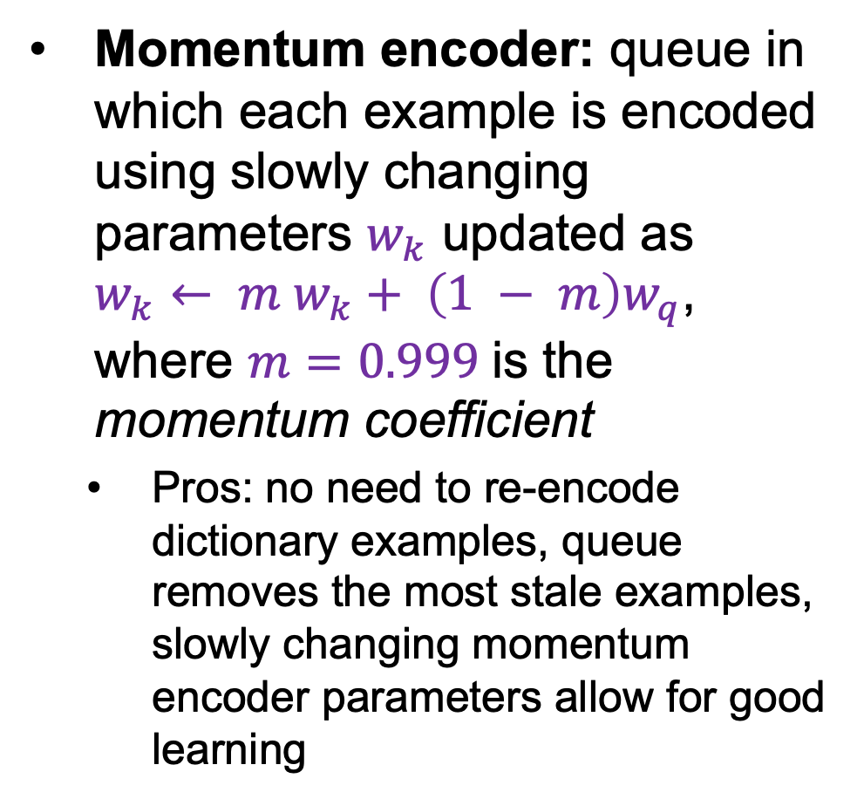
Mechanisms for obtaining negative samples
Momentum encoder: queue in which each example is encoded using slowly changing parameters $w_{k}$ updated as $w_{k}← m{ w}_{k}+ \left(1 − m\right)w_{q}$, where $m=0.999$is the momentum coefficient
Pros: no need to re-encode dictionary examples, queue removes the most stale examples, slowly changing momentum encoder parameters allow for good learning
query
(pos. data point)
key from dictionary
(neg. data point)
K. He et al. Momentum Contrast for Unsupervised Visual Representation Learning. CVPR 2020
Notes:
From the paper (Section 3.2): Denoting the parameters of fk as θk and those of fq as θq, we update θk by: θk ← mθk + (1 − m)θq. m is a momentum coefficient. Only the parameters θq are updated by back-propagation. The momentum update in Eqn.(2) makes θk evolve more smoothly than θq. As a result, though the keys in the queue are encoded by different encoders (in different mini-batches), the difference among these encoders can be made small. In experiments, a relatively large momentum (e.g., m = 0.999, our default) works much better than a smaller value (e.g., m = 0.9), suggesting that a slowly evolving key encoder is a core to making use of a queue.

Slide 39
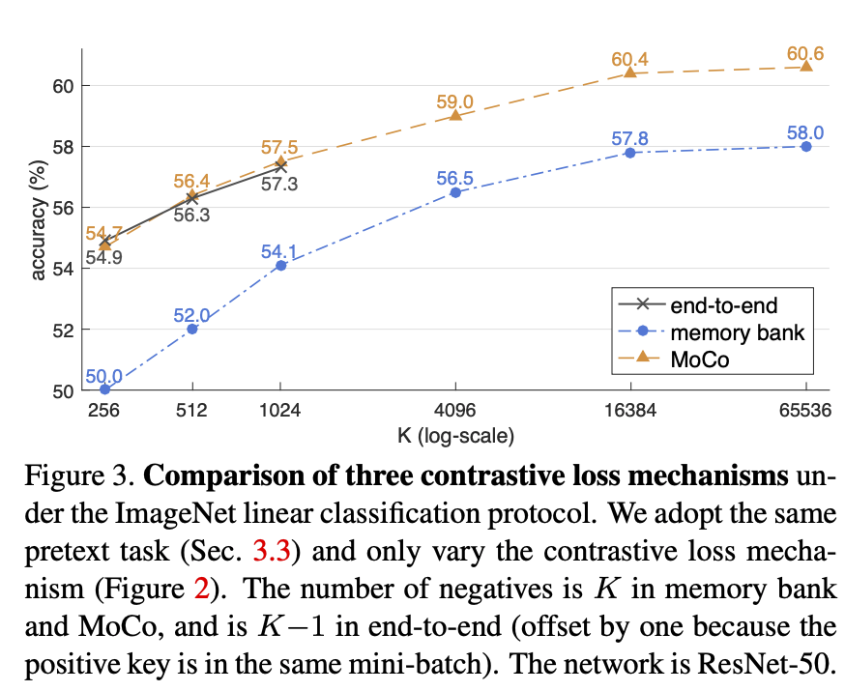
Mechanisms for obtaining negative samples
K. He et al. Momentum Contrast for Unsupervised Visual Representation Learning. CVPR 2020

Slide 40
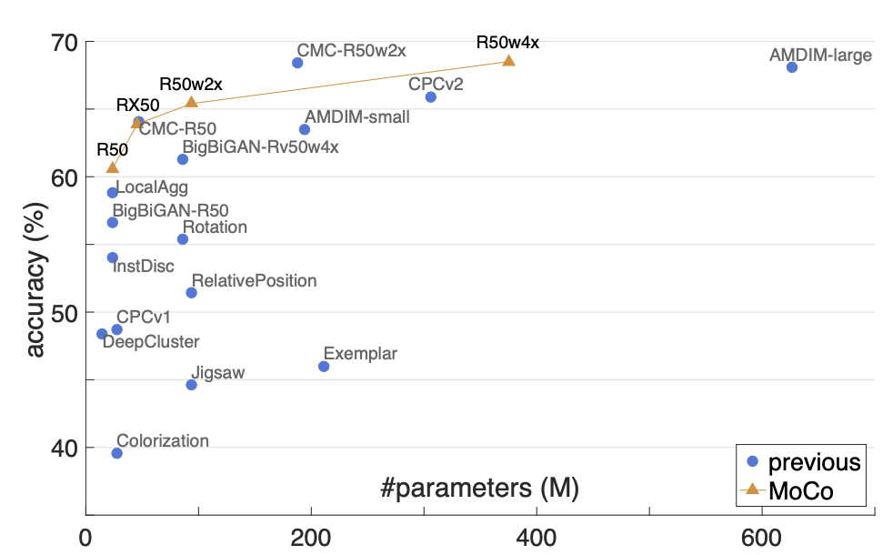
MoCo results
Comparison on linear ImageNet classification
(supervised accuracy above 75%)
K. He et al. Momentum Contrast for Unsupervised Visual Representation Learning. CVPR 2020

Slide 41
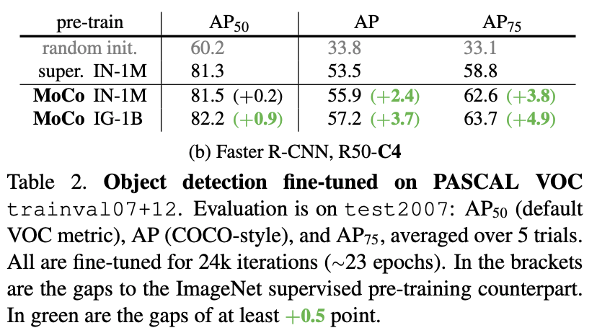
MoCo results
Comparison on PASCAL object detection
K. He et al. Momentum Contrast for Unsupervised Visual Representation Learning. CVPR 2020

Slide 42


SimCLR
Instead of memory bank or queue, use large mini-batch size (on cloud TPU)
Introduce nonlinear projection ($g$) between representation ($h$) and feature used for computing contrastive loss ($z$)
T. Chen, S. Kornblith, M. Norouzi, and G. Hinton. A Simple Framework for Contrastive Learning of Visual Representations. ICML 2020
Notes:
From the paper: We conjecture that the importance of using the representation before the nonlinear projection is due to loss of information induced by the contrastive loss. In particular, z = g(h) is trained to be invariant to data transformation. Thus, g can remove information that may be useful for the downstream task, such as the color or orientation of objects. By leveraging the nonlinear transformation g(·), more information can be formed and maintained in h.

Slide 43


SimCLR
Performed extensive ablation study of data augmentations
Found that composing multiple augmentations gives the best results
T. Chen, S. Kornblith, M. Norouzi, and G. Hinton. A Simple Framework for Contrastive Learning of Visual Representations. ICML 2020

Slide 44

SimCLR: Evaluation
No detection evaluation
T. Chen, S. Kornblith, M. Norouzi, and G. Hinton. A Simple Framework for Contrastive Learning of Visual Representations. ICML 2020

Slide 45
Why do contrastive methods work?
L2 normalization of features (before computing dot product to estimate similarity) is important (Wang and Isola, 2020)
The essential property of the loss is enforcing closeness of positive features while maximizing uniformity of the distribution of normalized features over the hypersphere (Wang and Isola, 2020)
The choice of data augmentation operations or transformations between two positive “views” is also important and needs further study (Tian et al., 2020)

Slide 46
Non-contrastive methods
Extract representations from two transformed versions of a data point, encourage these representations to be similar
Contrastive methods: train using both positive (similar) and negative (dissimilar) pairs
Key challenge: sampling of negative pairs
Non-contrastive methods: train with only positive examples
Key challenge: avoiding degenerate solutions (all representations collapsing to constant output value)
Data $T(x)$
Network
Similarity score
Data $T′(x)$
Network
Source: A. Efros

Slide 47

BYOL
Online branch uses projection like SimCLR, plus an additional prediction head to predict the target representation
Target branch uses momentum encoder, but there is no need for queue of negative examples
J.-B. Grill et al. Bootstrap Your Own Latent A New Approach to Self-Supervised Learning. NeurIPS 2020

Slide 48

BYOL: Evaluation

Slide 49

SimSiam
Like BYOL, but without the momentum encoder
Like SimCLR, but without the negative pairs
X. Chen and K. He. Exploring Simple Siamese Representation Learning. CVPR 2021
Notes:
From the paper: [SimSiam] can be thought of as “BYOL without the momentum encoder”. Unlike BYOL but like SimCLR and SwAV, our method directly shares the weights between the two branches, so it can also be thought of as “SimCLR without negative pairs”.

Slide 50

SimSiam: Evaluation
X. Chen and K. He. Exploring Simple Siamese Representation Learning. CVPR 2021

Slide 51

SimSiam: Evaluation
X. Chen and K. He. Exploring Simple Siamese Representation Learning. CVPR 2021

Slide 52


DINO: Self-distillation with no labels
M. Caron et al. Emerging Properties in Self-Supervised Vision Transformers. ICCV 2021

Slide 53

DINO
M. Caron et al. Emerging Properties in Self-Supervised Vision Transformers. ICCV 2021

Slide 54

Barlow Twins
Get rid of asymmetric encoders, stop-gradients
To avoid degeneracy, force cross-correlation matrix of “twin” embeddings to be close to identity – this tries to make individual dimensions of embeddings non-redundant
Use projection head that expands dimensions
J. Zbontar et al. Barlow Twins: Self-Supervised Learning via Redundancy Reduction. ICML 2021

Slide 55



Barlow Twins
J. Zbontar et al. Barlow Twins: Self-Supervised Learning via Redundancy Reduction. ICML 2021

Slide 56

Barlow Twins: Evaluation
J. Zbontar et al. Barlow Twins: Self-Supervised Learning via Redundancy Reduction. ICML 2021

Slide 57

Barlow Twins: Evaluation
J. Zbontar et al. Barlow Twins: Self-Supervised Learning via Redundancy Reduction. ICML 2021

Slide 58


VICReg
A. Bardes et al. VICReg: Variance-Invariance-Covariance Regularization for Self-Supervised Learning. ICLR 2022

Slide 59
VICReg
Advantages over Barlow Twins:
More general and applicable to cross-modal data: “does not require that the weights of the two branches be shared, not that the architectures be identical, nor that the inputs be of the same nature”
Including the variance preservation term removes the need to use normalized correlation matrix
A. Bardes et al. VICReg: Variance-Invariance-Covariance Regularization for Self-Supervised Learning. ICLR 2022

Slide 60

VICReg: Evaluation
A. Bardes et al. VICReg: Variance-Invariance-Covariance Regularization for Self-Supervised Learning. ICLR 2022

Slide 61

VICReg: Evaluation
A. Bardes et al. VICReg: Variance-Invariance-Covariance Regularization for Self-Supervised Learning. ICLR 2022

Slide 62
Self-supervised learning: Outline
Data prediction
Colorization, inpainting
Transformation prediction
Context prediction, jigsaw puzzle solving, rotation prediction
“Siamese” methods
Contrastive methods
Non-contrastive methods
Self-supervision beyond still images
Video, audio, language

Slide 63

Learning from audio
A. Owens et al. Ambient Sound Provides Supervision for Visual Learning. ECCV 2016

Slide 64

Ego-motion features
D. Jayaraman and K. Grauman. Learning image representations tied to ego-motion. ICCV 2015

Slide 65


Video correspondence features
A. Jabri, A. Owens, and A. Efros. Space-time correspondence as a contrastive random walk. NeurIPS 2020

Slide 66

Future prediction
J. Walker et al. An Uncertain Future: Forecasting from Static Images Using Variational Autoencoders. ECCV 2016

Slide 67

Future prediction
C. Finn and S. Levine. Deep Visual Foresight for Planning Robot Motion. ICRA 2017

Slide 68
Self-supervised learning in NLP (coming up)
word2vec, GloVe, BERT, ELMO, GPT, …
Figure source

Slide 69
Preview: Self-supervised learning with transformers
K. He et al. Masked autoencoders are scalable vision learners. CVPR 2022

Slide 70
Preview: Self-supervised learning with transformers
K. He et al. Masked autoencoders are scalable vision learners. CVPR 2022

Slide 71


Preview: Self-supervised learning with transformers
K. He et al. Masked autoencoders are scalable vision learners. CVPR 2022

Slide 72
For further reading
https://github.com/jason718/awesome-self-supervised-learning
https://people.eecs.berkeley.edu/~efros/gelato_bet.html

